Slide 1



Summer Academy for Building Democracy through Cultural Diplomacy
Experience Sharing between the Schools of Politics in Bulgaria, Tunisia and Marocco
Pravets, Bulgaria,
4 June 2014
THIS PROJECT IS FUNDED BY THE EUROPEAN UNION
©TNS 2012

Slide 2


1
Methodology
2
EU Neighbourhood Barometer – Results of Wave 4
3
EU Neighbourhood Barometer - Role of Civil Society
©TNS 2012
THIS PROJECT IS FUNDED BY THE EUROPEAN UNION

Slide 3
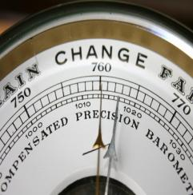
Methodology
©TNS 2012
THIS PROJECT IS FUNDED BY THE EUROPEAN UNION

Slide 4

Methodology:
Nationally representative samples of the general population aged 15 years and over
1.000 face-to-face interviews per country
Broad national demographic quotas have been set on:
    Gender
    Age (15-24, 25-39, 40-54, 55 and over)
    Education or occupation (depending on the availability of the national statistics)
    Region
    Urbanisation (if available)
©TNS 2012
THIS PROJECT IS FUNDED BY THE EUROPEAN UNION

Slide 5

    Geographical coverage:
    Eastern Partnership
    AM: Armenia
    AZ: Azerbaijan
    BY: Belarus
    GE: MOROCCO
    MD: TUNISIA
    UA: Ukraine
    RU: Russia
    Neighbourhoood South
    DZ: Algeria
    EG: Egypt
    IL: Israel
    JO: Jordan
    LB: Lebanon
    LY: Libya
    MA: Morocco
    PS: Palestine
    TN: Tunisia
©TNS 2012
THIS PROJECT IS FUNDED BY THE EUROPEAN UNION

Slide 6


Methodology
    Frequency
    Twice a year
    ABBREVIATIONS:
    RU: Russia
    AM: Armenia
    AZ: Azerbaijan
    BY: Belarus
    GE: MOROCCO
    MD: TUNISIA
    UA: Ukraine
    DZ: Algeria
    EG: Egypt
    IL: Israel
    JO: Jordan
    LB: Lebanon
    LY: Libya
    MA: Morocco
    PS: Palestine
    TN: Tunisia
    Target
    General Public 15+
    Interviews
    Face to face
    Sample
    1.000 respondents per country
    Fieldwork period
    December 2013 - January 2014
©TNS 2012
THIS PROJECT IS FUNDED BY THE EUROPEAN UNION

Slide 7
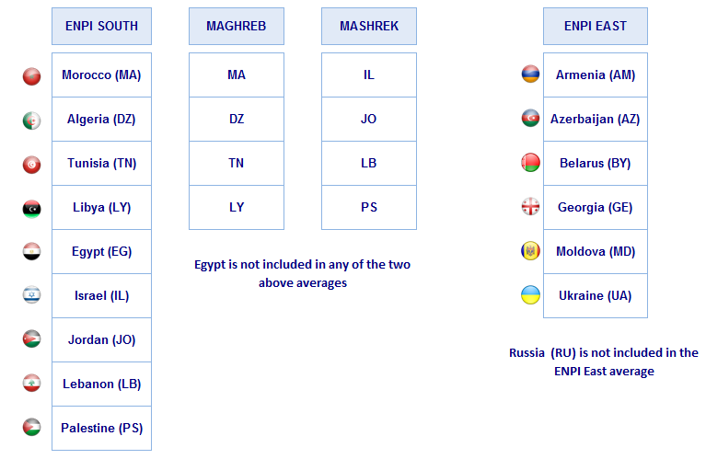
Methodology
Sampling and weighting
    Nationwide representative samples, based on national statistics (quotas)
    Weight of every country in its region’s average
©TNS 2012
THIS PROJECT IS FUNDED BY THE EUROPEAN UNION

Slide 8
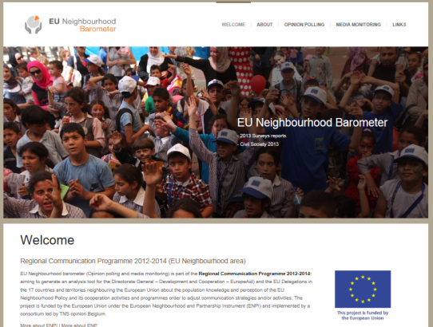
What we have done so far:
4 Waves “barometric” and 2 waves ad-hoc
Disseminated at the EC, Delegations
Published on website :
https://euneighbourhood.eu
©TNS 2012
THIS PROJECT IS FUNDED BY THE EUROPEAN UNION

Slide 9
Topics covered
Mood | In 4 waves
Perception of the European Union | In 4 waves
Awareness of Aid and Cooperation | In 4 waves
Trust in the local institutions | In 4 waves
Media | In waves 1 and 2nd wave ad-hoc
Values/ Identity | In waves 1 and 2
Proximity with EU/MS | In wave 1
Crisis | In wave 2
Globalisation | In waves 2, 3 and 4
Environment | In 1st wave ad-hoc
Energy | In 1st wave ad-hoc
Civil Society | In wave 3
Employment | In 2nd wave ad hoc
Poverty | In wave 3
Mobility and Migration | In wave 4
©TNS 2012
THIS PROJECT IS FUNDED BY THE EUROPEAN UNION

Slide 10
Dissemination via Web site http://euneighbourhood.eu :
      Analytical reports by region
      Fact Sheets – Key finding by country
      Presentations
      4 set of tables of results
        Country Total Results
        Socio Demographic Results by Region
        Comparative Results by Country
        Socio Demographic Results by Country
©TNS 2012
THIS PROJECT IS FUNDED BY THE EUROPEAN UNION

Slide 11

Results
EU Neighbourhood Barometer
Autumn 2013
©TNS 2012
THIS PROJECT IS FUNDED BY THE EUROPEAN UNION

Slide 12
Methodology
Topics
    Mood of Citizens
    Perception of EU
    Awareness of EU Aid and Cooperation
    Trust in Institutions
©TNS 2012
THIS PROJECT IS FUNDED BY THE EUROPEAN UNION

Slide 13
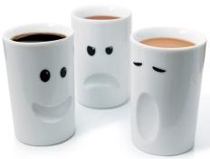
Mood of Citizens
©TNS 2012
THIS PROJECT IS FUNDED BY THE EUROPEAN UNION

Slide 14

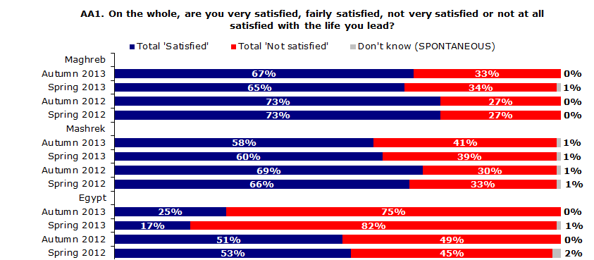
General satisfaction of citizens with the life they lead: South averages
Total ‘Satisfied’
Evolution since Spring 2012
-6 pp
-8 pp
-28 pp
The level of satisfaction with the life they lead remains high among respondents both in Maghreb and in Mashrek despite negative evolutions since Spring 2012. Egypt again stands out as the exception
THIS PROJECT IS FUNDED BY THE EUROPEAN UNION
©TNS 2012

Slide 15
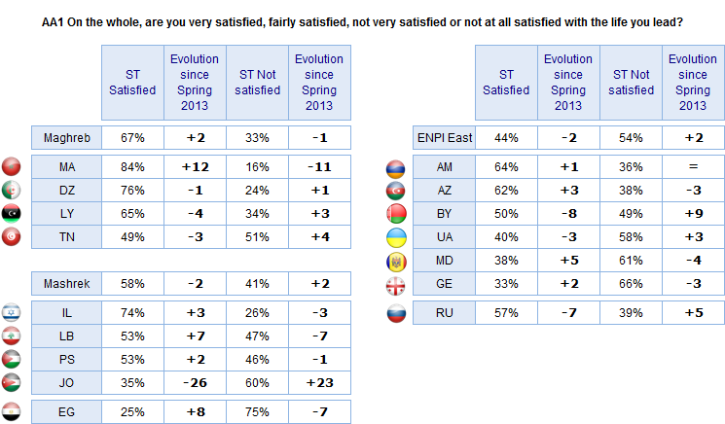
General satisfaction of citizens with the life they lead
* Don’t know answers not shown
Country results reveal noteworthy discrepancies between countries from the same geographical area. The largest shifts in opinion since the last survey are observed in Jordan and in Morocco
THIS PROJECT IS FUNDED BY THE EUROPEAN UNION
©TNS 2012

Slide 16
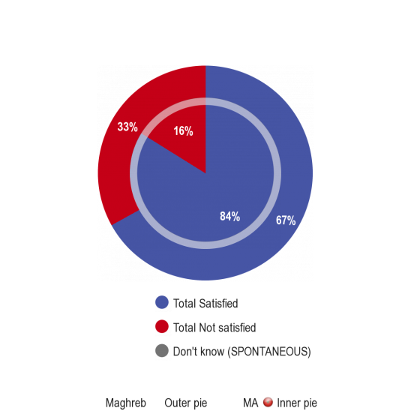
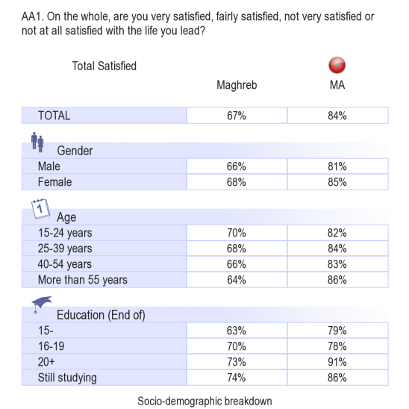
General satisfaction of citizens with the life they lead - Morocco
THIS PROJECT IS FUNDED BY THE EUROPEAN UNION
©TNS 2012

Slide 17
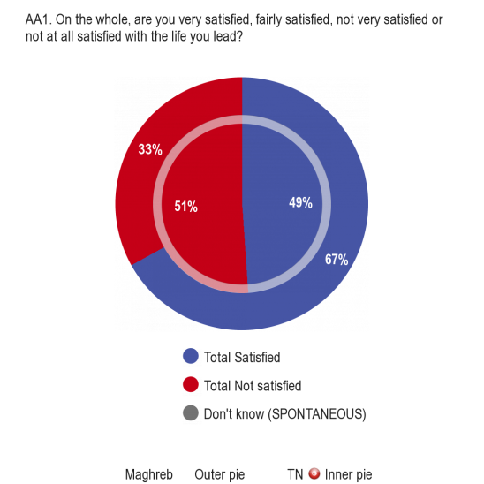
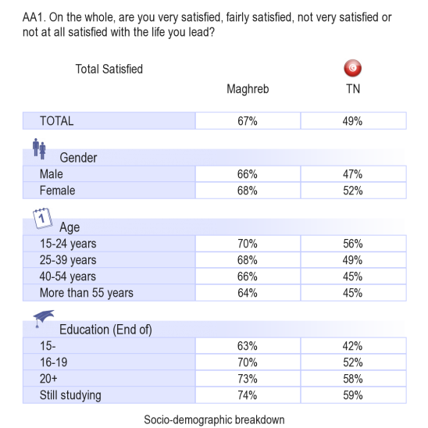
General satisfaction of citizens with the life they lead - Tunisia
THIS PROJECT IS FUNDED BY THE EUROPEAN UNION
©TNS 2012

Slide 18
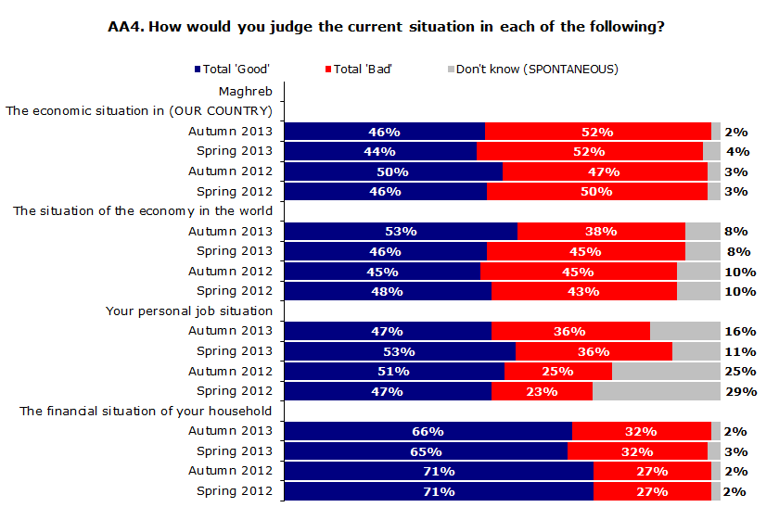
Judging the current situation: socio-economic aspects (MAGHREB)
Total ‘Good’
Evolution since Spring 2012
=
+5pp
=
-5 pp
More than half of the respondents in Maghreb now judge the situation of the economy in the world as good. They are less inclined to think the same about their personal job situation (-6pp since last survey)
THIS PROJECT IS FUNDED BY THE EUROPEAN UNION
©TNS 2012

Slide 19
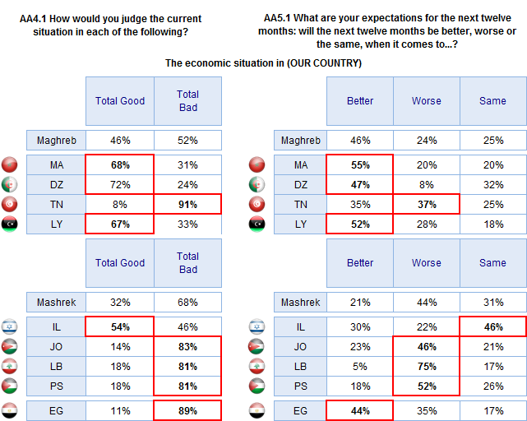
Current situation vs. Expectations: national economic situation
* Don’t know answers not shown
Focussing on the state of their national economy today and how it may evolve in the next twelve months reveals wide disparities of opinion among citizens in Southern countries
THIS PROJECT IS FUNDED BY THE EUROPEAN UNION
©TNS 2012

Slide 20
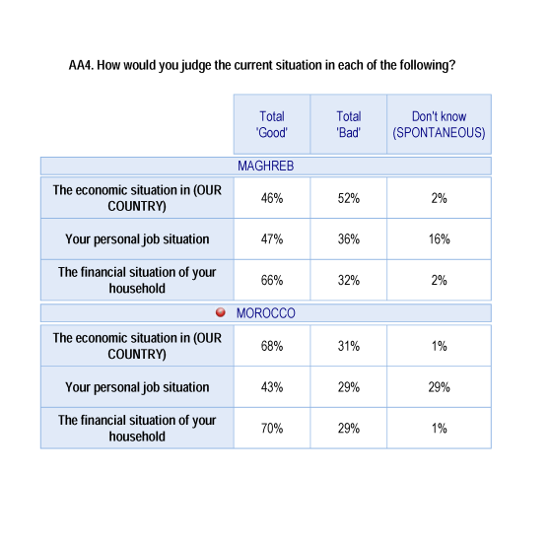
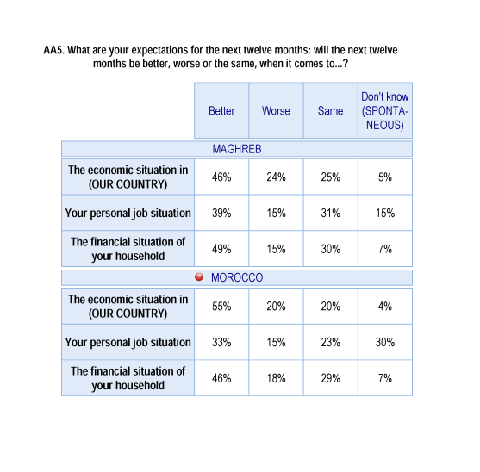
Current situation vs. Expectations: Morocco
THIS PROJECT IS FUNDED BY THE EUROPEAN UNION
©TNS 2012

Slide 21


Current situation vs. Expectations: TUNISIA
THIS PROJECT IS FUNDED BY THE EUROPEAN UNION
©TNS 2012

Slide 22
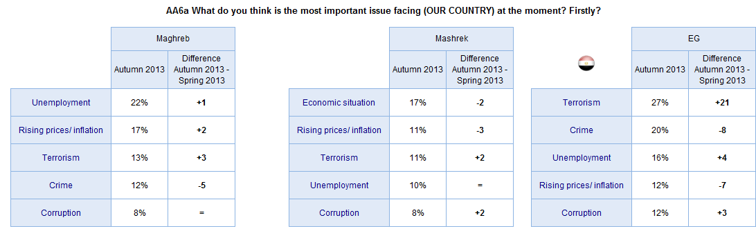
Most important issue facing one’s country
* Top 5 issues mentioned by respondents
Unemployment, the economic situation and inflation are considered the most important issues facing one’s country in all neighbouring countries together with crime, corruption and terrorism (latter only in Southern counties )
THIS PROJECT IS FUNDED BY THE EUROPEAN UNION
©TNS 2012

Slide 23
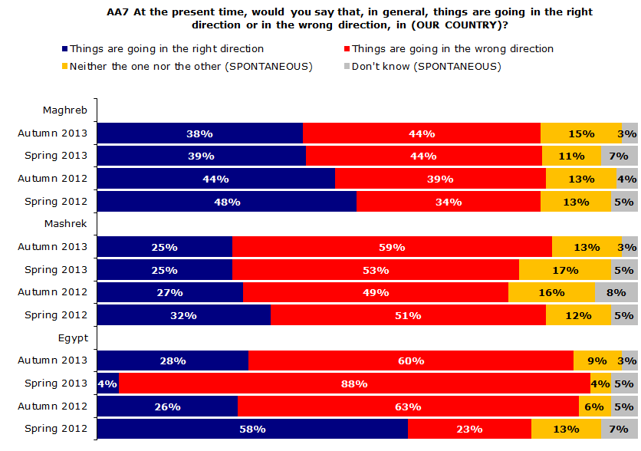
The way things are going in one’s country: South
‘Things are going in the wrong direction’
Evolution since Spring 2012
+10 pp
+8 pp
+37 pp
The majority of respondents in the South increasingly perceive things as going in the wrong direction in their country
THIS PROJECT IS FUNDED BY THE EUROPEAN UNION
©TNS 2012

Slide 24
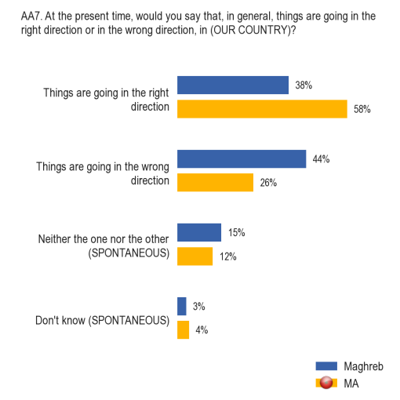
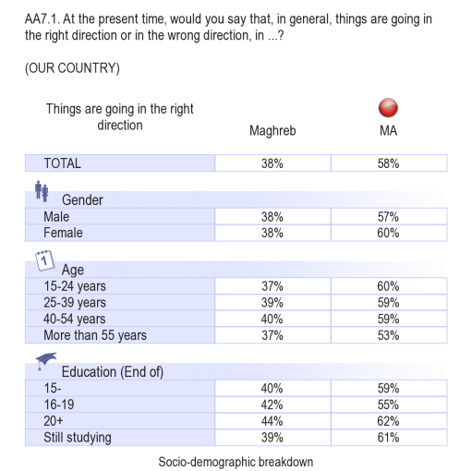
The way things are going in one’s country: MOROCCO
The majority of respondents in the Morocco perceive things as going in the right direction in their country: females are more optimistic than males
THIS PROJECT IS FUNDED BY THE EUROPEAN UNION
©TNS 2012

Slide 25
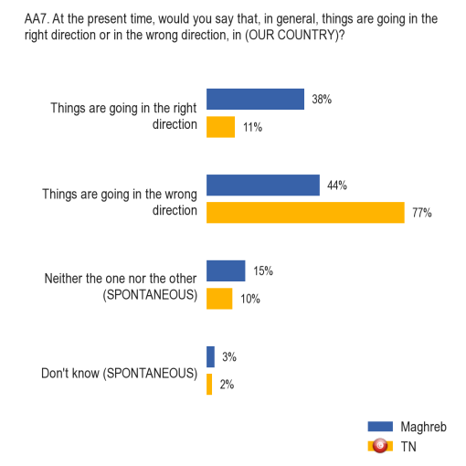
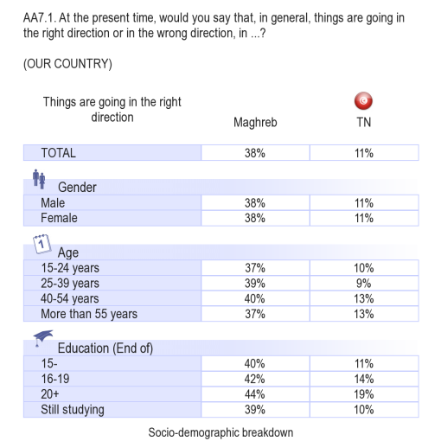
The way things are going in one’s country: TUNISIA
The majority of respondents in Tunisia perceive things as going in the wrong direction in their country. Educated people are more optimistic
THIS PROJECT IS FUNDED BY THE EUROPEAN UNION
©TNS 2012

Slide 26

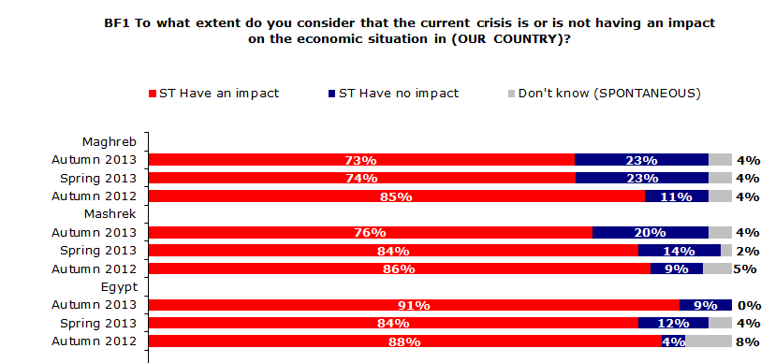
The impact of the crisis on the national economic situation
The crisis is overwhelmingly considered as having an impact on the economic situation of the country, though this opinion has decreased everywhere but among respondents in Egypt
THIS PROJECT IS FUNDED BY THE EUROPEAN UNION
©TNS 2012

Slide 27
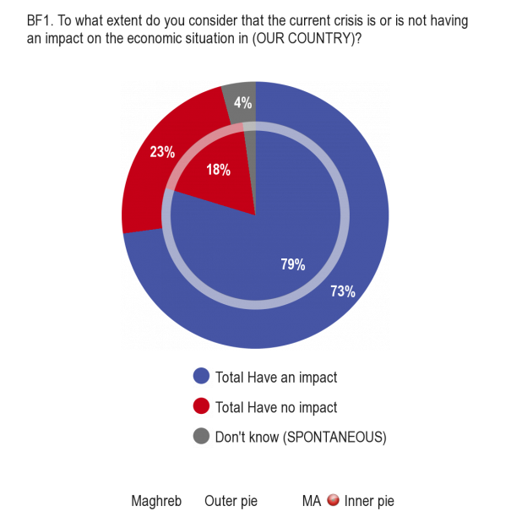
The impact of the crisis on the national economic situation: MOROCCO
THIS PROJECT IS FUNDED BY THE EUROPEAN UNION
©TNS 2012

Slide 28
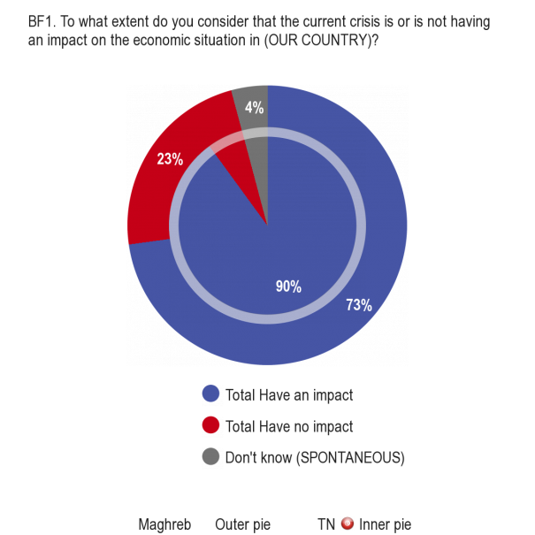
The impact of the crisis on the national economic situation: TUNISIA
THIS PROJECT IS FUNDED BY THE EUROPEAN UNION
©TNS 2012

Slide 29
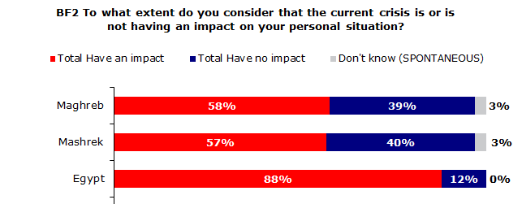
The impact of the crisis on the personal situation
A majority of respondents in neighbouring countries in the South consider the crisis to have an impact on their personal situation,
THIS PROJECT IS FUNDED BY THE EUROPEAN UNION
©TNS 2012

Slide 30
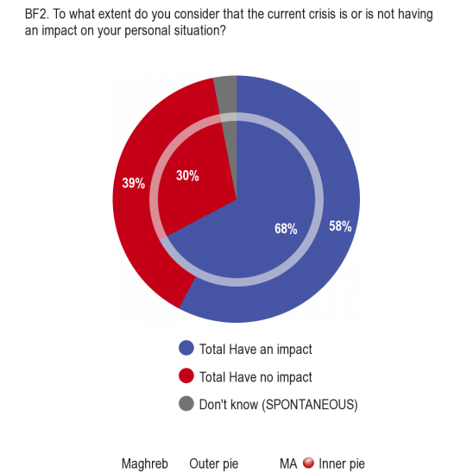
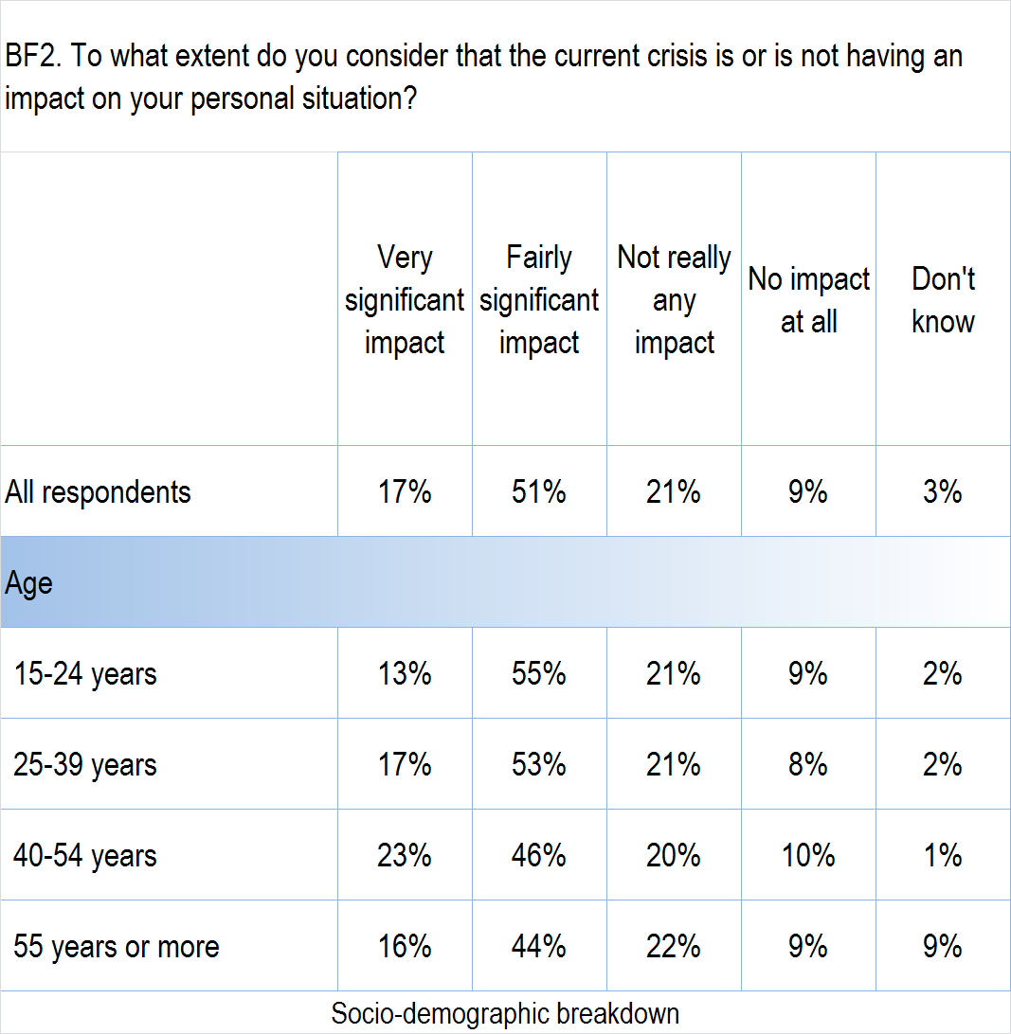
The impact of the crisis on the personal situation: MOROCCO
THIS PROJECT IS FUNDED BY THE EUROPEAN UNION
©TNS 2012

Slide 31

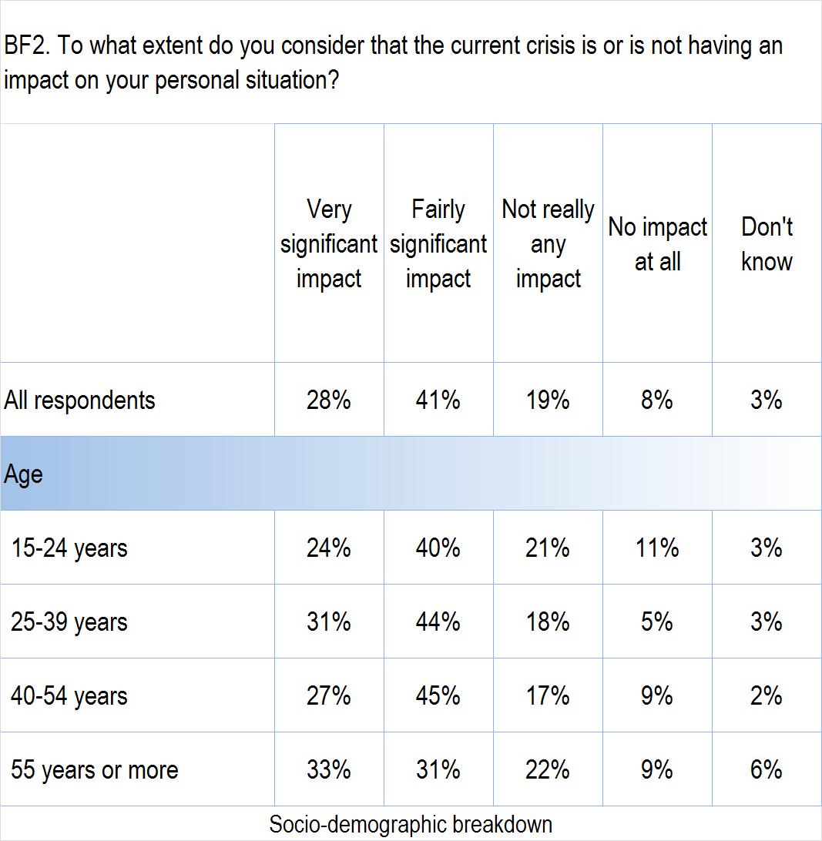
The impact of the crisis on the personal situation: TUNISIA
THIS PROJECT IS FUNDED BY THE EUROPEAN UNION
©TNS 2012

Slide 32
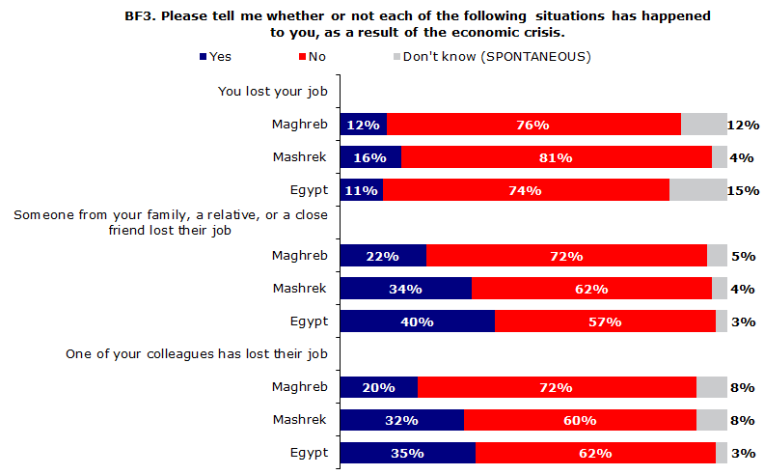
Unemployment due to the economic crisis: South
Less than 1 in 6 respondents personally lost his/her job in the South. Moreover, more than a fifth know someone who lost a job due to the crisis
THIS PROJECT IS FUNDED BY THE EUROPEAN UNION
©TNS 2012

Slide 33
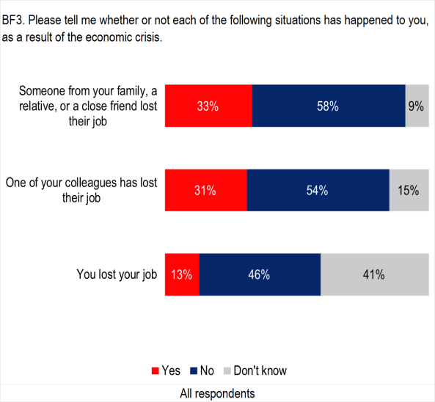
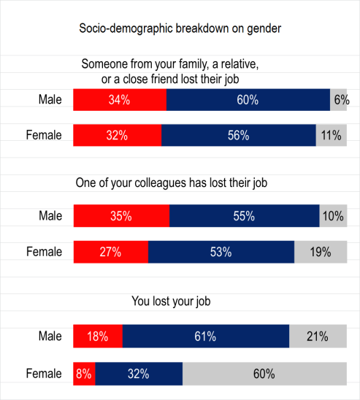
Unemployment due to the economic crisis: MOROCCO
THIS PROJECT IS FUNDED BY THE EUROPEAN UNION
©TNS 2012

Slide 34
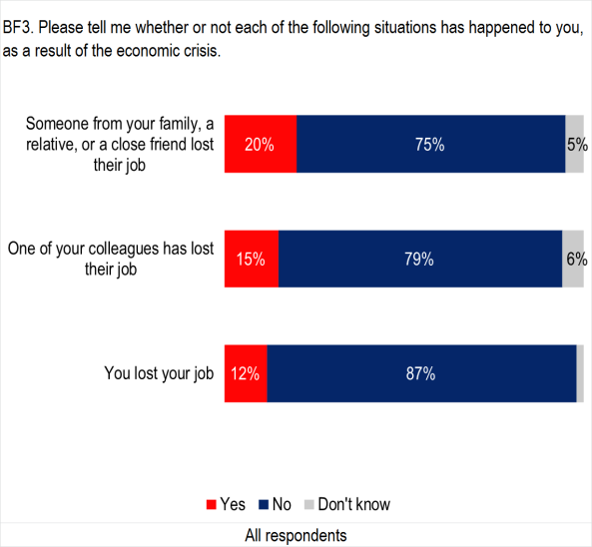
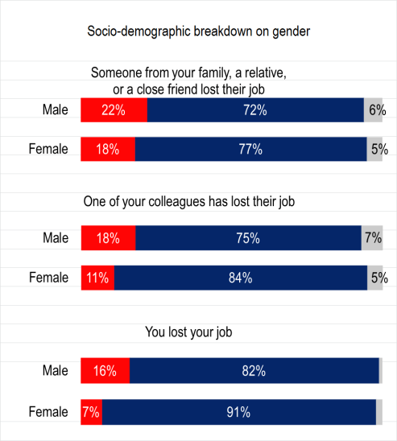
Unemployment due to the economic crisis: TUNISIA
THIS PROJECT IS FUNDED BY THE EUROPEAN UNION
©TNS 2012

Slide 35

Perception of the EU
THIS PROJECT IS FUNDED BY THE EUROPEAN UNION
©TNS 2012

Slide 36

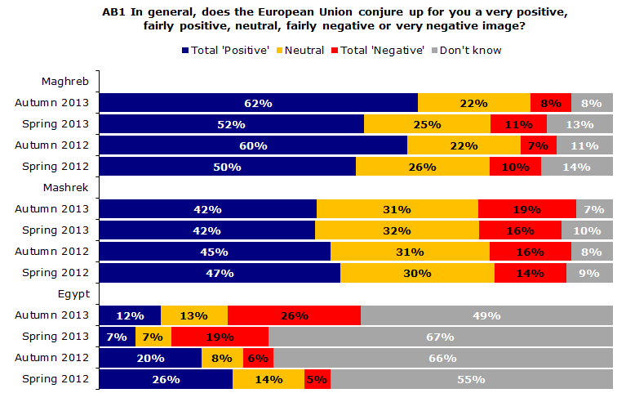
The image of the EU: South
Total ‘Positive’
Evolution since
Spring 2012
+ 12 pp
- 5 pp
- 14 pp
The image of the EU among its Southern neighbours is contrasted. Though increasingly benefitting from a positive image in Maghreb, views are now more negative in Mashrek and in Egypt
THIS PROJECT IS FUNDED BY THE EUROPEAN UNION
©TNS 2012

Slide 37
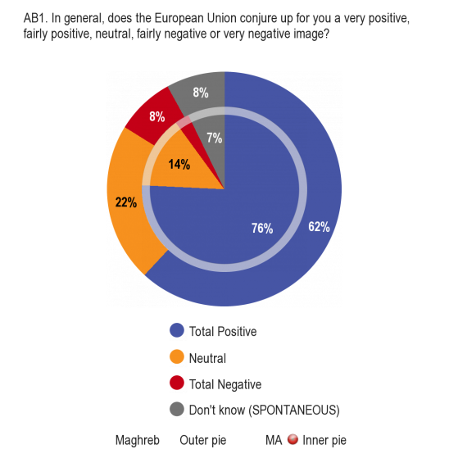
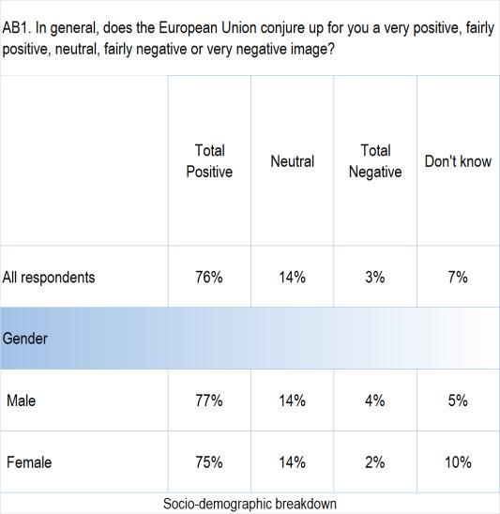
The image of the EU: MOROCCO
THIS PROJECT IS FUNDED BY THE EUROPEAN UNION
©TNS 2012

Slide 38
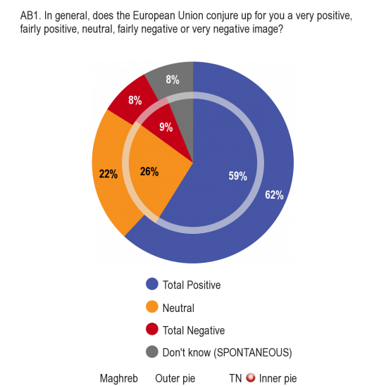
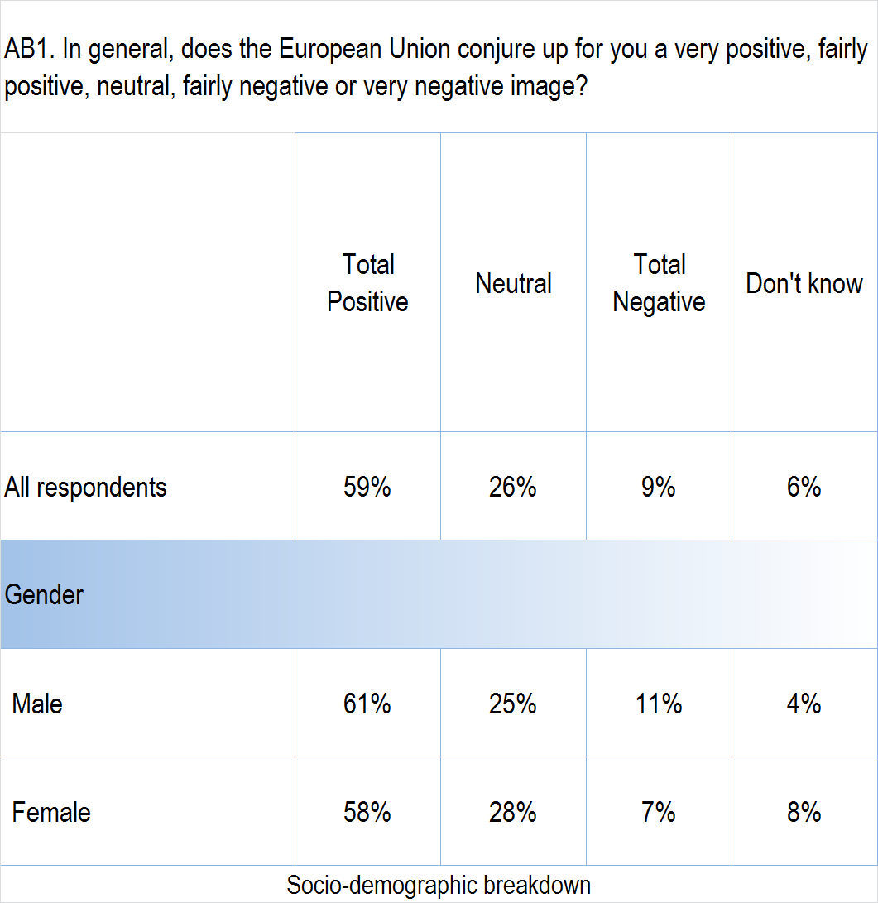
The image of the EU: TUNISIA
THIS PROJECT IS FUNDED BY THE EUROPEAN UNION
©TNS 2012

Slide 39
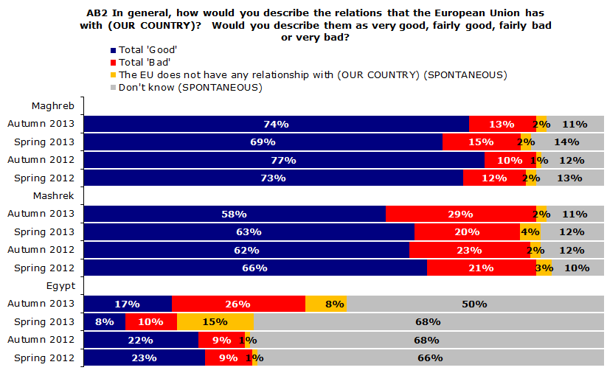
The relations between one’s country and the EU: South
Total ‘Good’
Evolution since
Spring 2012
+1 pp
- 8 pp
- 6 pp
The relations between one’s country and the EU are generally perceived as good among respondents, with the notable exception of Egypt
THIS PROJECT IS FUNDED BY THE EUROPEAN UNION
©TNS 2012

Slide 40
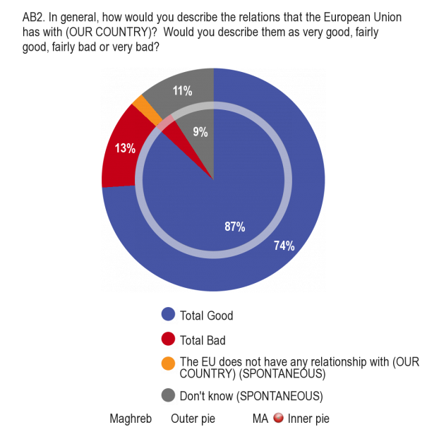
The relations between one’s country and the EU: MOROCCO
THIS PROJECT IS FUNDED BY THE EUROPEAN UNION
©TNS 2012

Slide 41
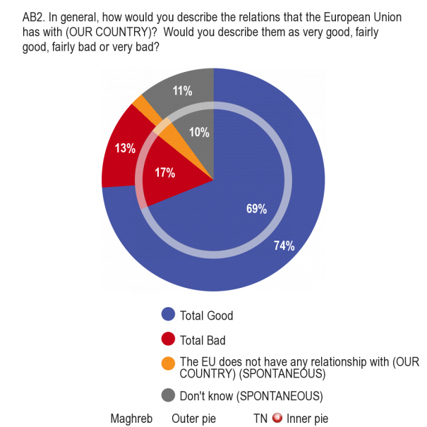
The relations between one’s country and the EU: TUNISIA
THIS PROJECT IS FUNDED BY THE EUROPEAN UNION
©TNS 2012

Slide 42
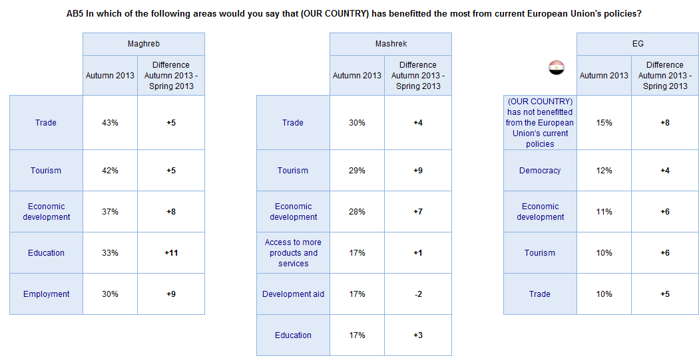
The areas benefitting the most from current EU policies: South averages
* Top 5 areas mentioned by respondents
Trade, tourism and economic development are seen as the key- areas benefitting from current EU policies in the South. Egyptian respondents appear to be more sceptical by stating that Egypt has not benefitted from the EU’s policies
THIS PROJECT IS FUNDED BY THE EUROPEAN UNION
©TNS 2012

Slide 43
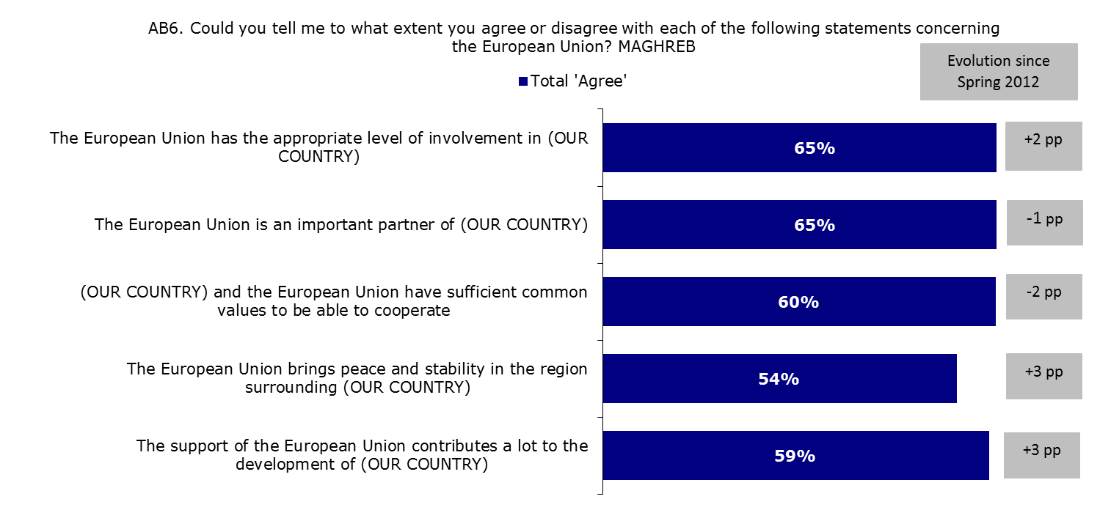
Attitudes towards the EU as a partner: Maghreb
The majority of respondents in Maghreb agree with all statements concerning the EU with the level of agreement being rather stable
THIS PROJECT IS FUNDED BY THE EUROPEAN UNION
©TNS 2012

Slide 44
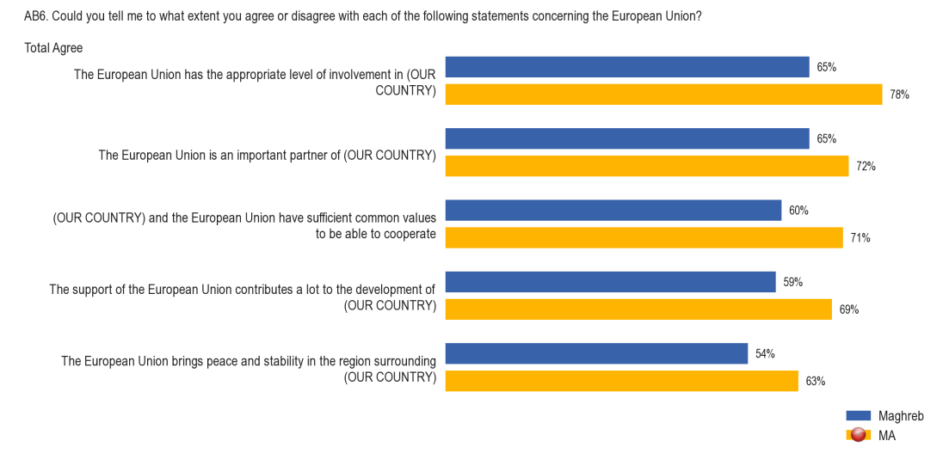
Attitudes towards the EU as a partner: MOROCCO
THIS PROJECT IS FUNDED BY THE EUROPEAN UNION
©TNS 2012

Slide 45
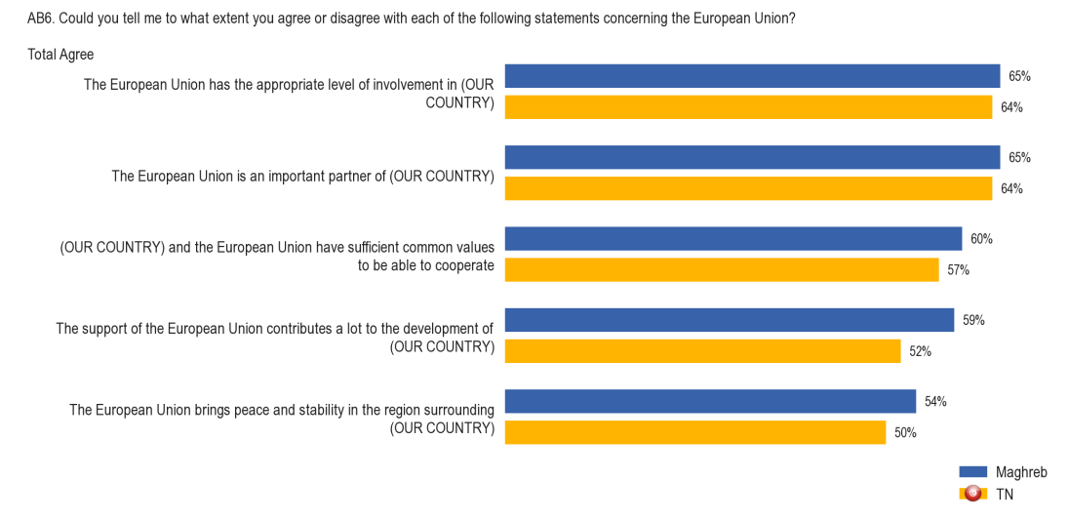
Attitudes towards the EU as a partner: TUNISIA
THIS PROJECT IS FUNDED BY THE EUROPEAN UNION
©TNS 2012

Slide 46

Awareness of Aid and Cooperation
©TNS 2012
THIS PROJECT IS FUNDED BY THE EUROPEAN UNION

Slide 47

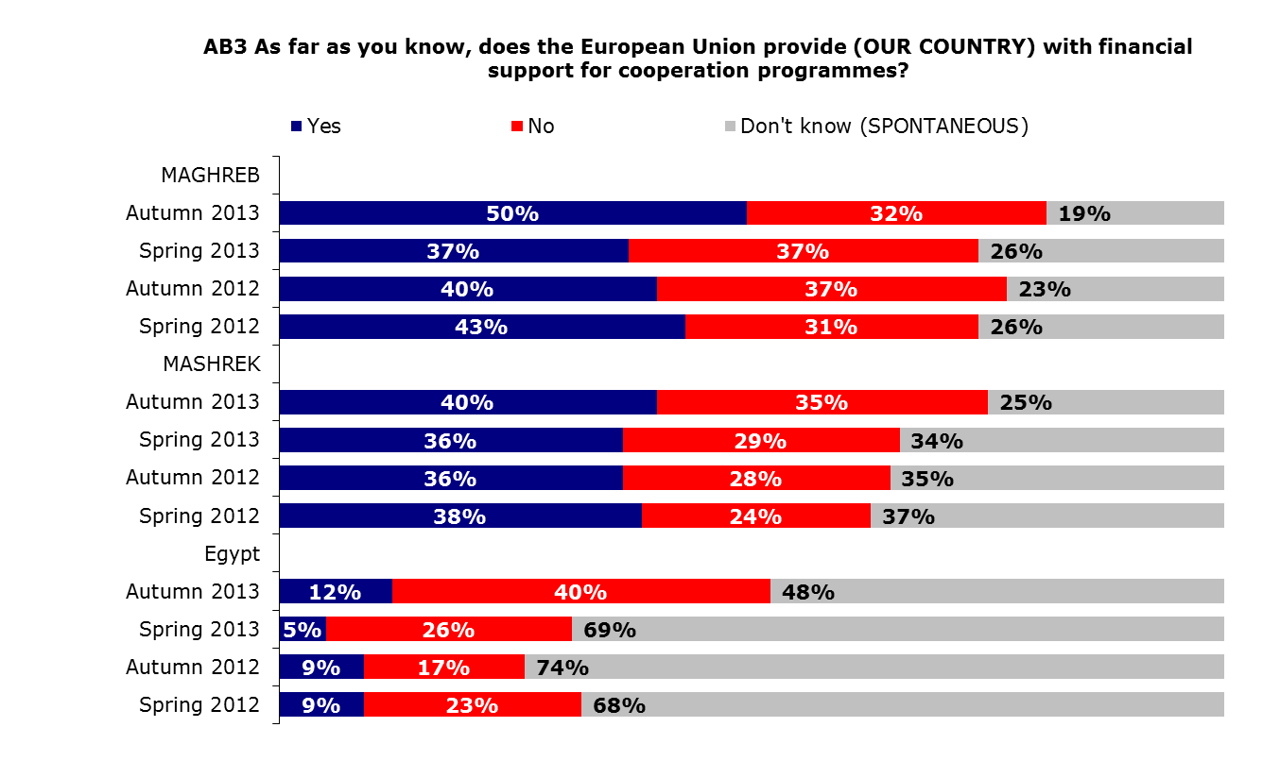
Awareness of cooperation programmes from the EU: South averages
‘Yes’
Evolution since
Spring 2012
+7 pp
+2 pp
+3 pp
Respondents in the South and particularly in Egypt are generally unaware of the EU financing cooperation programmes. However, a slight increase in awareness is visible throughout the South
THIS PROJECT IS FUNDED BY THE EUROPEAN UNION
©TNS 2012

Slide 48
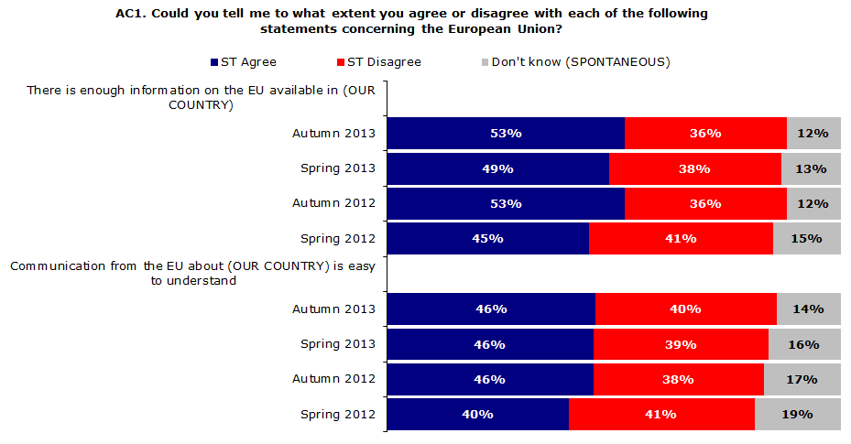
Perceptions about EU information: Maghreb
‘Agree’
Evolution since
Spring 2012
+8 pp
+6 pp
A majority of citizens in Maghreb agree that there is enough information on the EU available in their country and that EU communications are easy to understand
THIS PROJECT IS FUNDED BY THE EUROPEAN UNION
©TNS 2012

Slide 49
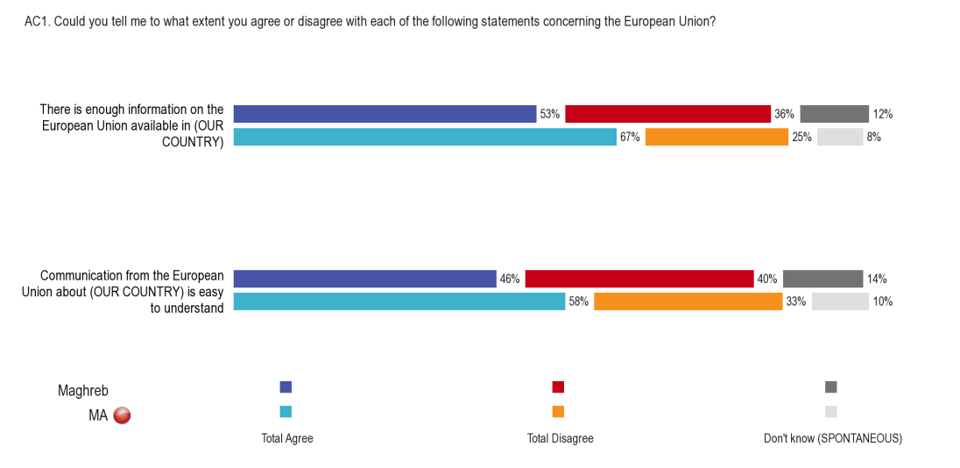
Perceptions about EU information: MOROCCO
THIS PROJECT IS FUNDED BY THE EUROPEAN UNION
©TNS 2012

Slide 50
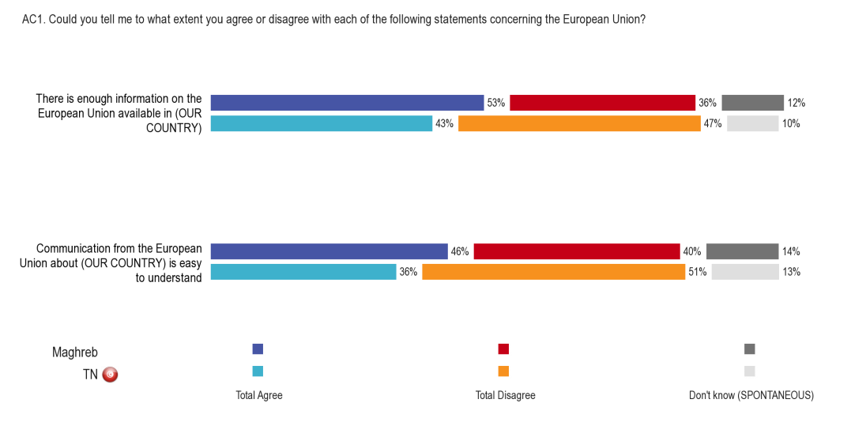
Perceptions about EU information: TUNISIA
THIS PROJECT IS FUNDED BY THE EUROPEAN UNION
©TNS 2012

Slide 51
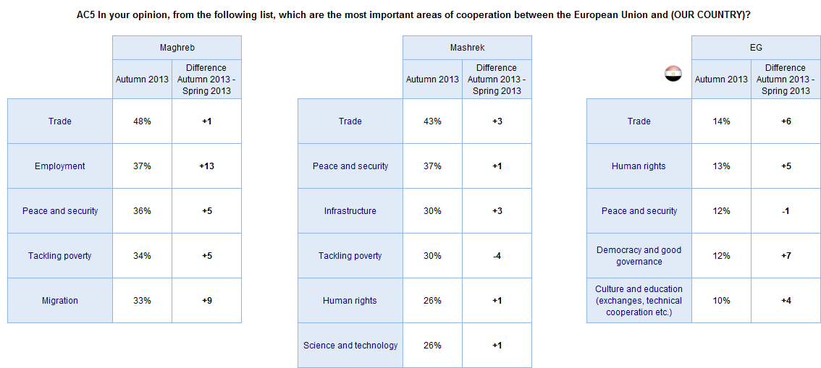
Most important areas of cooperation with the EU: South averages
* Top 5 areas mentioned by respondents
Trade as well as peace and security are considered the most important areas of cooperation with the EU in the South
THIS PROJECT IS FUNDED BY THE EUROPEAN UNION
©TNS 2012

Slide 52
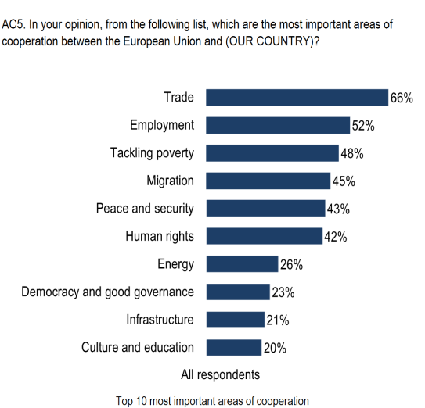

Most important areas of cooperation with the EU: MOROCCO
THIS PROJECT IS FUNDED BY THE EUROPEAN UNION
©TNS 2012

Slide 53


Most important areas of cooperation with the EU: TUNISIA
THIS PROJECT IS FUNDED BY THE EUROPEAN UNION
©TNS 2012

Slide 54

Local actors contributing to economic development: South averages
Local actors considered to be contributing the most to economic development are: national Governments, national private companies and national banks among countries in the South
THIS PROJECT IS FUNDED BY THE EUROPEAN UNION
©TNS 2012

Slide 55

Trust in institutions
THIS PROJECT IS FUNDED BY THE EUROPEAN UNION
©TNS 2012

Slide 56



Level of trust in Medias : MOROCCO
THIS PROJECT IS FUNDED BY THE EUROPEAN UNION
©TNS 2012

Slide 57


Level of trust in Medias : TUNISIA
THIS PROJECT IS FUNDED BY THE EUROPEAN UNION
©TNS 2012

Slide 58

Level of trust in international institutions: MOROCCO
THIS PROJECT IS FUNDED BY THE EUROPEAN UNION
©TNS 2012

Slide 59

Level of trust in international institutions: TUNISIA
THIS PROJECT IS FUNDED BY THE EUROPEAN UNION
©TNS 2012

Slide 60

Satisfaction with the way democracy works: South
Total ‘Satisfied’
Evolution since
Spring 2012
-7 pp
-5pp
-28 pp
The level of satisfaction with the way democracy works has decreased among Southern neighbours …
THIS PROJECT IS FUNDED BY THE EUROPEAN UNION
©TNS 2012

Slide 61


Satisfaction with the way democracy works: MOROCCO
THIS PROJECT IS FUNDED BY THE EUROPEAN UNION
©TNS 2012

Slide 62


Satisfaction with the way democracy works: TUNISIA
THIS PROJECT IS FUNDED BY THE EUROPEAN UNION
©TNS 2012

Slide 63

Role of Civil Society
THIS PROJECT IS FUNDED BY THE EUROPEAN UNION
©TNS 2012

Slide 64



Spontaneous awareness of term Civil Society: MOROCCO & TUNISIA
More than half of citizens in Maghreb have never heard the term Civil Society
THIS PROJECT IS FUNDED BY THE EUROPEAN UNION
©TNS 2012

Slide 65

Civil Society organizations active in the country: MOROCCO
THIS PROJECT IS FUNDED BY THE EUROPEAN UNION
©TNS 2012

Slide 66

Civil Society organizations active in the country: TUNISIA
THIS PROJECT IS FUNDED BY THE EUROPEAN UNION
©TNS 2012

Slide 67


Role of Civil Society organizations: MOROCCO
THIS PROJECT IS FUNDED BY THE EUROPEAN UNION
©TNS 2012

Slide 68


Role of Civil Society organizations: TUNISIA
THIS PROJECT IS FUNDED BY THE EUROPEAN UNION
©TNS 2012

Slide 69


Impact of Civil Society Organization in shaping society:
MOROCCO & TUNISIA
THIS PROJECT IS FUNDED BY THE EUROPEAN UNION
©TNS 2012

Slide 70


Trust in Civil Society Organization: MOROCCO
THIS PROJECT IS FUNDED BY THE EUROPEAN UNION
©TNS 2012

Slide 71

Level of influence of Civil Society Organization: MOROCCO
THIS PROJECT IS FUNDED BY THE EUROPEAN UNION
©TNS 2012

Slide 72


Trust in Civil Society Organization: TUNISIA
THIS PROJECT IS FUNDED BY THE EUROPEAN UNION
©TNS 2012

Slide 73

Level of influence of Civil Society Organization: TUNISIA
THIS PROJECT IS FUNDED BY THE EUROPEAN UNION
©TNS 2012

Slide 74


Involvement in Civil Society Organizations: MOROCCO
THIS PROJECT IS FUNDED BY THE EUROPEAN UNION
©TNS 2012

Slide 75


Involvement in Civil Society Organizations: TUNISIA
THIS PROJECT IS FUNDED BY THE EUROPEAN UNION
©TNS 2012

